Slide 1



PeopleSpace Final Presentation
HYR
AI Resume Builder
By Team HYR
Thomas (Tae Un, Lee)
Yeong (Yeong-Chan, Choi)
Angela (Ji-Hyeon, Park)
James (Min-Jun, Choi)

Slide 2

HYR
OUR PROCESS

Slide 3

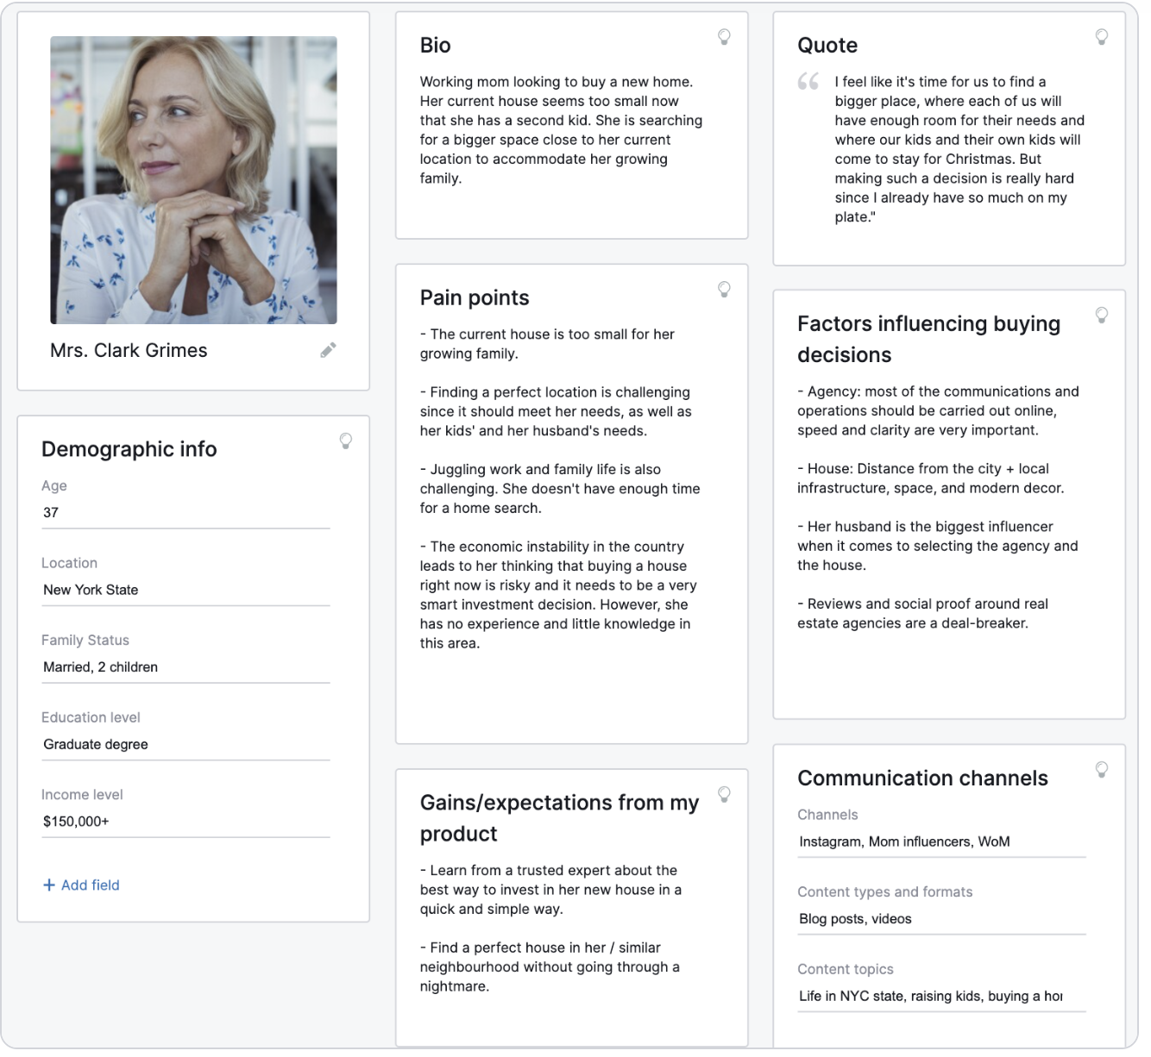


HYR
Team Making
Base Operations
Team Making
Topic : AI Resume Builder
Install WordPress
To make Website
Create Persona
To empathize with users

Slide 4

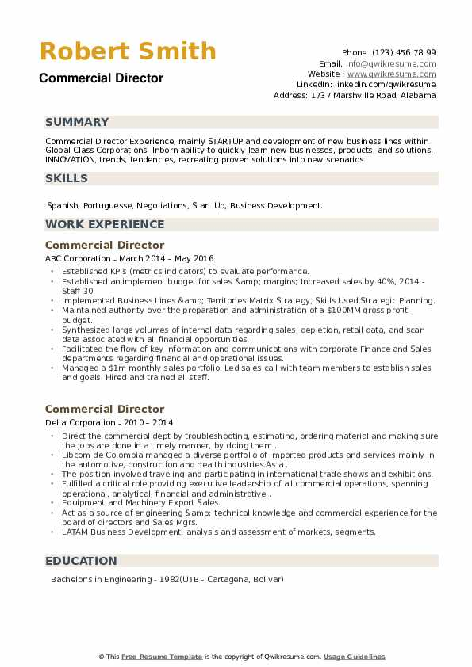

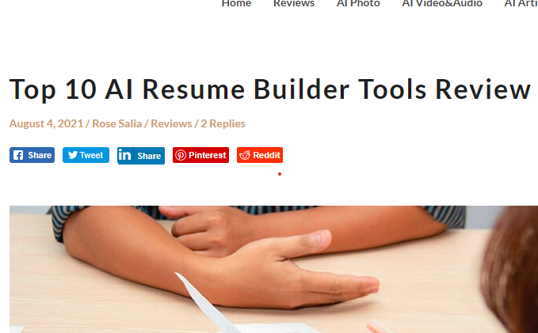
HYR
Data Research
Making BMI
Create a dataset
50 Resumes,
50 Job Descriptions
Research existing service
For market research
Make BMI

Slide 5

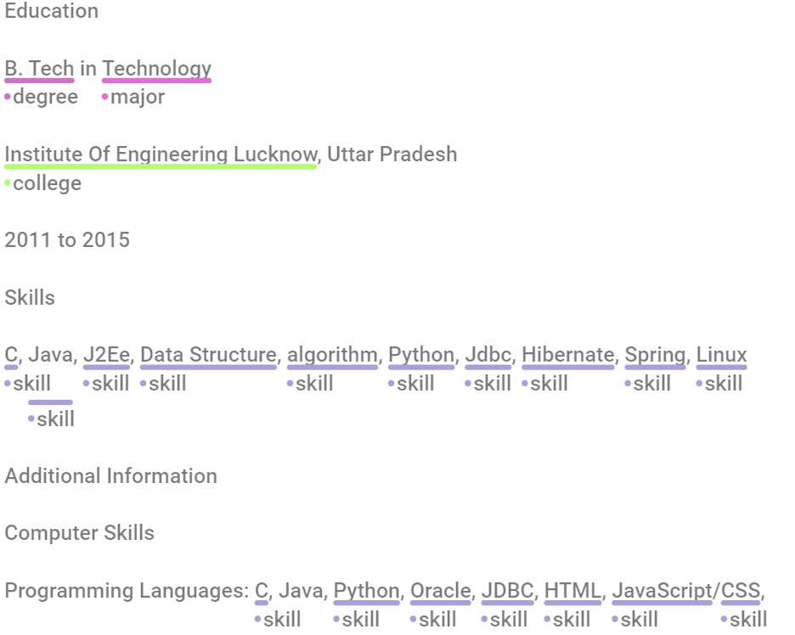
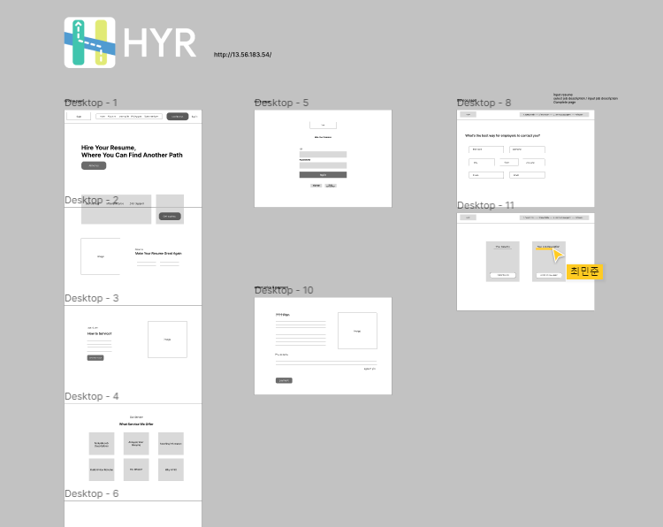
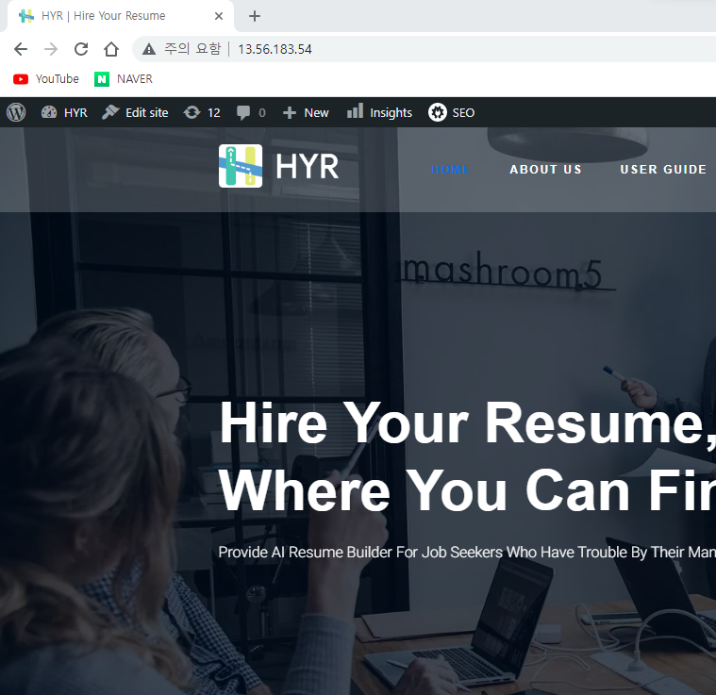
HYR
Annotate, Wireframe, Website
Midterm PT
Annotate a dataset
with Doccano
Make Wireframe
With Figma
Make Website
With Wordpress

Slide 6

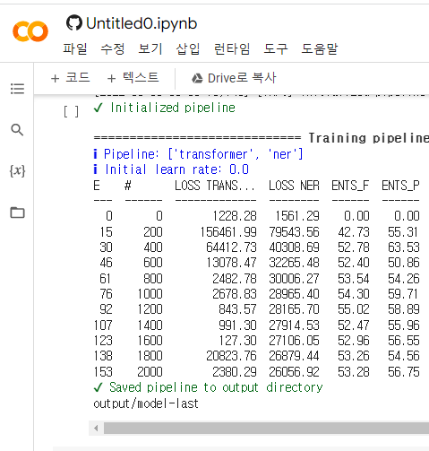

HYR
Train AI Model
Making SRS
Train AI model
With Spacy
Make SRS
To summary

Slide 7

HYR
OUR RESULTS

Slide 8
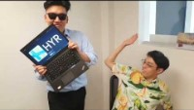
HYR
Advertisement

Slide 9
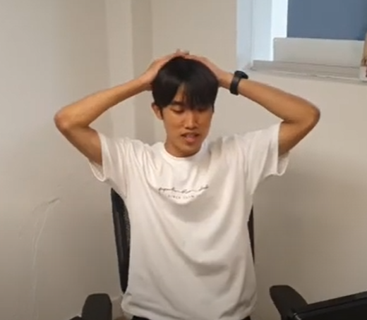
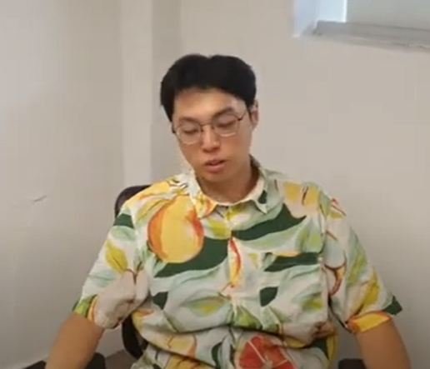
HYR
Advertisement
Explanation
Target audience : Who wants to get a new job

Slide 10
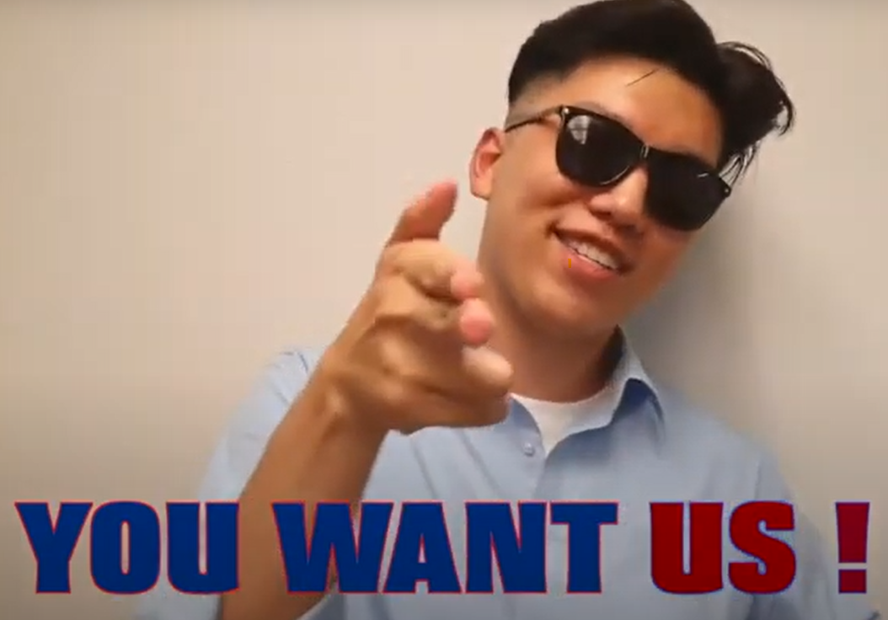

HYR
Advertisement
Explanation
Our Strength : Unlike other resume maker, build a customized resumes referring to the job descriptions

Slide 11
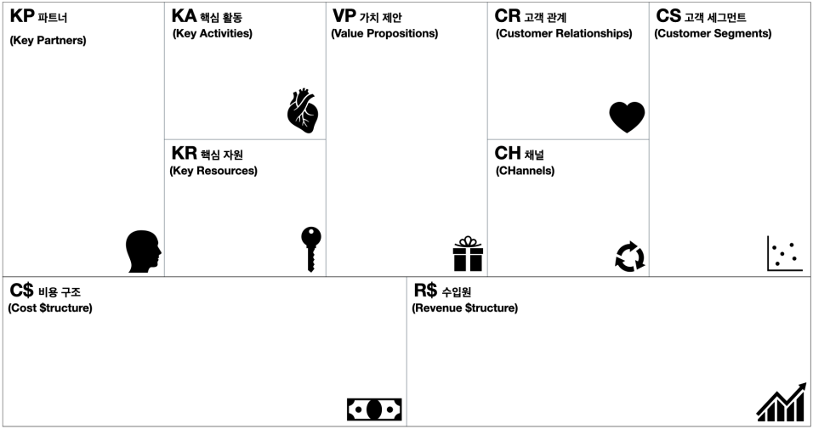
HYR
BMI
Developing AI system
Developing web site
Designing UI
…
Building a customized
resumes referring
to the job descriptions
Extracting user’s experience
to suit the job description
Extracting keyword
of job descriptions
AI building a resume
Optimized for each company
using extracted information
to simplify procedures
for candidates who have
diverse experience and
need to write several resumes
advanced candidates
who can apply
for various job
job searcher who need
to write a new resume
to change their job
Job research site
(ex.linkedin)
Web developer
AI developer
UI designer
...
banner ads
(online job-search site
and communities)
initial development cost
marketing cost
server maintenance cost
a fee for service
fixed rares a month

Slide 12

HYR
Website

Slide 13
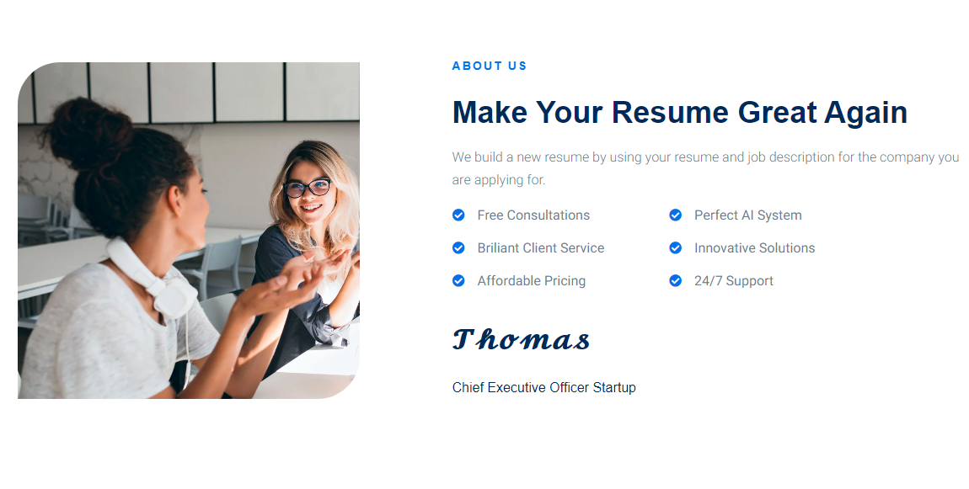
HYR
Website

Slide 14
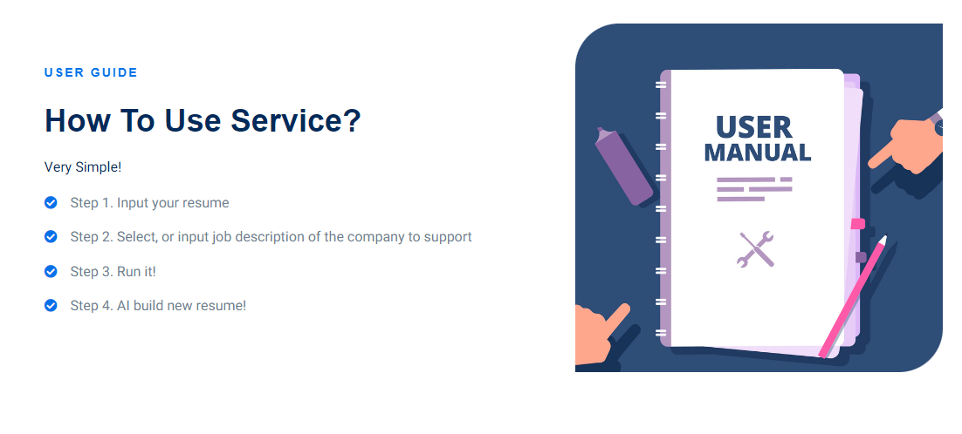
HYR
Website

Slide 15
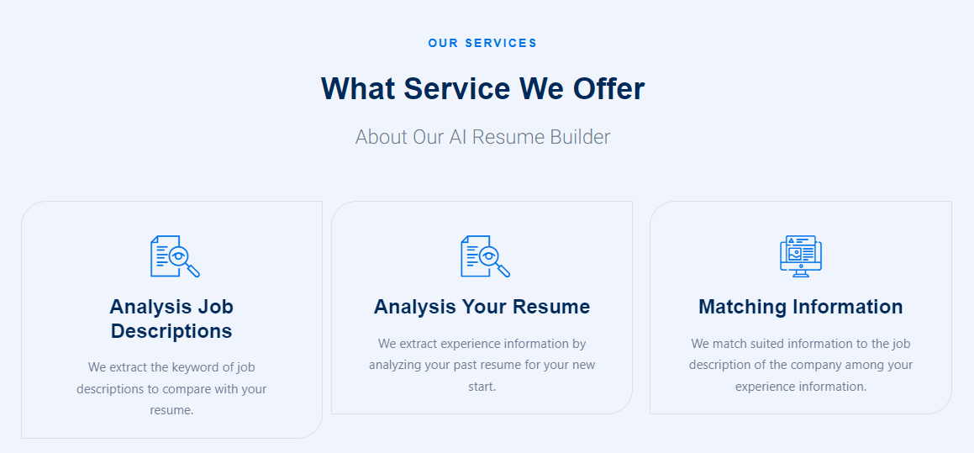
HYR
Website

Slide 16
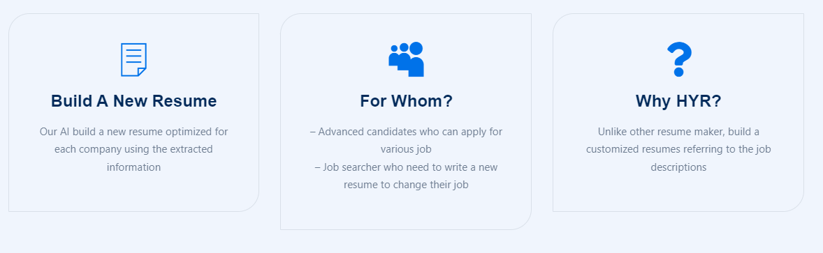
HYR
Website

Slide 17
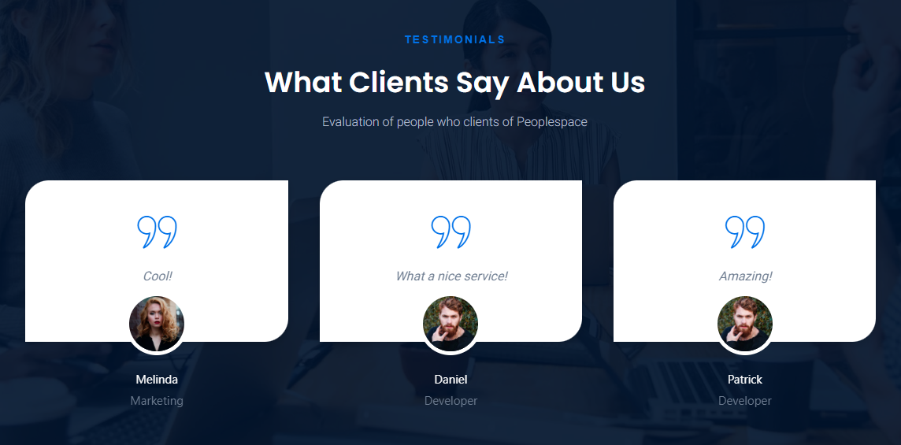
HYR
Website

Slide 18
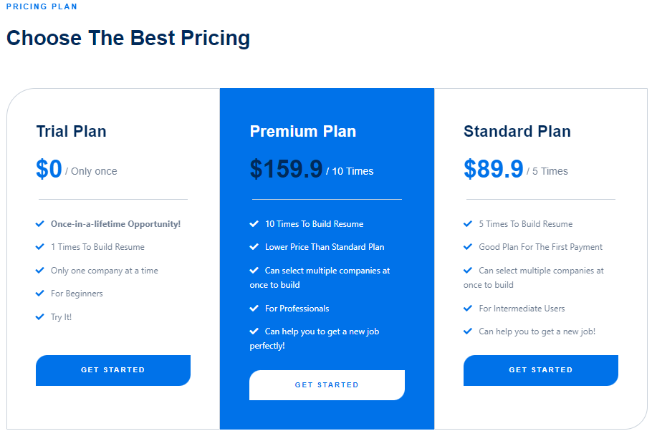
HYR
Website

Slide 19
HYR
Website(Survey)
Want to purchase this service?
Do you think the price of the service is reasonable?

Slide 20



HYR

Slide 21

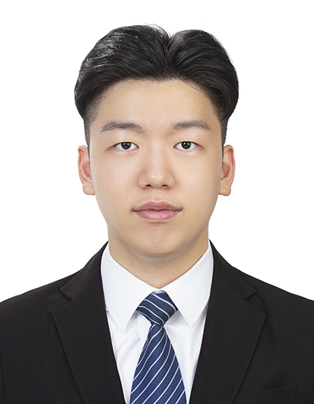
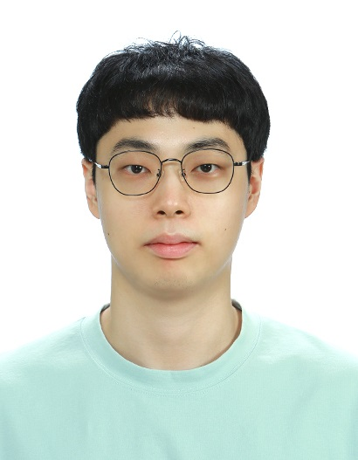
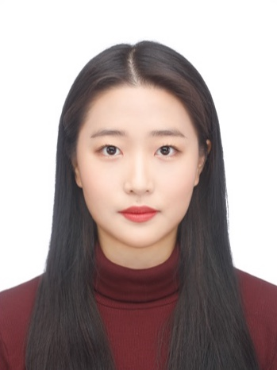

HYR
Team Members
Thomas
(Tae-Un, Lee)
Young
(Yeong-Chan, Choi)
Angela
(Ji-Hyeon, Park)
James
(Min-Jun, Choi)

Slide 22
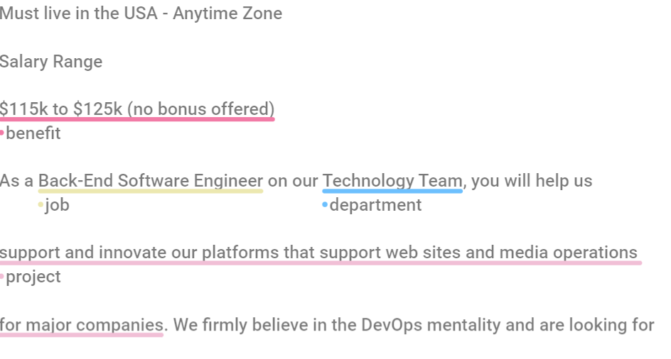
HYR
Annotate
With Doccano
Example of
annotated resume
Example of
Annotated job description

Slide 23

HYR
Training AI
With Spacy

Slide 24

HYR
Summary
With SRS

